Slide 1

Information Leaks

Slide 2
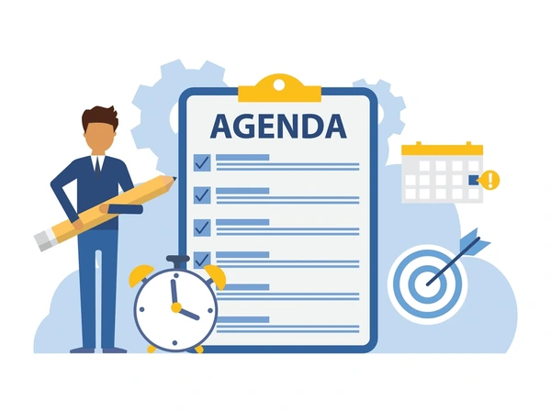
Agenda
Introduction
Types of Information Leaks
Real-world examples
Facebook-Cambridge Analytica Leaks
Ethical responsibilities
Prevention
Conclusion

Slide 3

Types of information leaks
Data breaches (hackers steal passwords/emails)
Insider leaks (employees leak information)
Misconfigured systems (databases left public)
Human error (sending information to the wrong people)

Slide 4

Real-world examples
Facebook-Cambridge Analytica – leaked personal data of 87 million users
Sony Pictures hack – leaked company emails and movies
Why was it wrong?
Violated user trust
Showed lack of security
Huge impact on people

Slide 5

Facebook-Cambridge Analytica leak
What happened?
  It got exposed that facebook allowed Cambridge Analytica to collect millions of user profiles
What did it reveal?
  Massive data misuse
  Influence of elections using personal data
Impact
  US and EU started new privacy laws
  Facebook got multi-billion dollar fines
  Big changes in how apps can access data

Slide 6
Ethical responsibilities
Protect personal information with privacy, fairness and transparency
Ensure accountability in handling cybersecurity incidents
Disclose vulnerabilities and support affected cosumers
Go beyond legal conpliance: treat data privacy as an ethical responsibility
Build trust through transparency and responsible practices

Slide 7

Prevention
Strong password/2 Factor Authentication
Proper encryption
Employee training
Regular security checks
Not collecting unneccessary data
Reporting leaks quickly
Testing

Slide 8
Thank you for your attention!

